Slide 1
Digitize Your Shipping Operations
April 2024

Slide 2
The LTL shipping industry is plagued by inefficiencies, lack of transparency, and outdated processes that hinder business growth
“MyCarrier has been a God-send for starting up our shipping department. We don’t have the time to log into 3 or 4 different websites to compare shipping rates, and we need to give our customers a fast/accurate freight quote via email or on the phone. MyCarrier is the easiest most accurate freight quote source we’ve found thus far.”
Joey H., Director of Sales, Federated Ordnance
“More and more, we’re seeing that carriers are choosing to work with shippers who can provide them with early, accurate information. Using MyCarrier has led to streamlined pickups and a reduction in business risk, securing capacity as a shipper of choice and saving us money, which is a must with the capacity issues the market is facing
right now.” ​
​
Jeremy J., Transportation Director, Lucas Oil

Slide 4
With 80+ years of freight experience, we know
what matters to shippers
MyCarrier was created to connect LTL shippers directly to their carriers for streamlined quoting, booking, and tracking. Our customers have found value in these capabilities, and we listened when they asked for more.
Because of the amazing feedback we've received, we've been able to build a shipping platform that transforms entire businesses with order-to-invoice automation, actionable data, and seamless integrations.
2,748,798 Shipments Booked in 2023
With almost 3 million shipments booked through MyCarrier last year and more than 15,000+ shipments per day, customers have kept their businesses moving forward with ease and efficiency.

Slide 10
Fully digitized shipping from order to invoice
Eliminate manual touch points, minimize mistakes, enhance operational efficiency, and generate cost savings for both shippers and carriers
ERP System
Carrier Quote
WMS System
MyCarrier
Carrier Quote
Dispatch & eBOL
Pick Up & BOL Scan
Carrier Auto Billing
Invoice Resolution
ERP Bill Creation
eCom System
Carrier Quote

Slide 11
Common Challenges

Slide 12
What we’re hearing from shippers
Ineffective Use of Workforce Talent and Cost Allocation
Data Latency and
Insufficient Visibility
Lack of Visibility Causing Poor Customer Experience
Gaps Between Locations, Processes, and Departments
Fragmented Manual Processes and Human-Induced Errors
Manual and Cumbersome Tasks That Slow Down
The Shipping Process

Slide 13
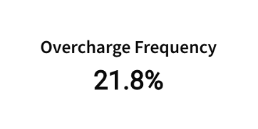
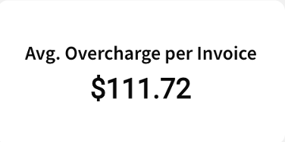
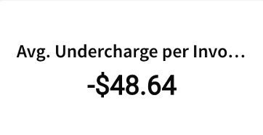
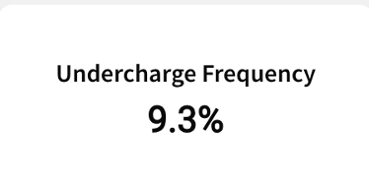
Business impacts
Lack of Financial Optimization: Operating without insight into costs could result in uncontrolled freight spend and decreased profitability.
Compromised Competitive Positioning: If not addressed, these issues could lead to lost customers, shrinking sales margins, and a declining market share.
Restrained Business Growth: Continued inefficiencies could result in higher operating costs, lower productivity, and potential errors—all of which have a severe impact on customer satisfaction.
Inefficient Processes and Increased Labor Costs: Lack of efficiency leads to ineffective use of workforce talent and hiring more employees than necessary - hindering the ability to scale.

Slide 14
Scale Your Business with MyCarrier

Slide 15
Transform your business with MyCarrier
Real-time Rate Comparison
Digital Freight Bill Audit & Resolution
Advanced Analytics
ERP Integrations and Order Creation
Connect to your LTL carriers for live rate quotes. Select the best carrier for your shipment, dispatch instantly, and send automated live tracking updates to your customers —all with a few clicks.
Access all your freight bills in one place, gaining instant visibility to discrepancies, and quickly resolving variances. Pay your Freight Carriers in a timely and accurate way.
Transform complex datasets into actionable insights, driving strategic decisions. Leverage comprehensive data and reporting to optimize freight activity, discern trends, and mitigate risks.
A robust set of integrations enable you to connect your business software directly to your TMS. No more jumping between systems. No more duplicate entries. No more errors.

Slide 16
Bridge the gap between departments
Before MyCarrier
Siloed departments, gaps in the shipping process, and bottlenecks between order and invoice.
After MyCarrier
Seamless end-to-end shipping that improves workflows and connects all the pieces of your business
Real Value for Each Department
Sales: Real-time quotes across all your carriers
Customer service: Live tracking for all shipments in one view
Accounting: Efficient, accurate freight audit
Operations: Comprehensive shipment and carrier reports
Owners: Full visibility into freight spend
Shipping Department
Owner
Customer Service
Shipping Department
Operations Manager
Shipping
Department becomes a bottleneck
Operations Manager
Accounting Team
Owner
Customer Service
Accounting Team

Slide 17
Create better business outcomes
Optimize Freight Spend
Determine the optimal cost carrier for each shipment
Optimize carrier selection and negotiate better rates
Significantly reduce shipping expenses and avoid overspending
Prevent overspending by instantly spotting overcharges and quickly resolving invoices
Successfully scale by automating manual processes and more efficiently allocating labor
Make Data-Driven Decisions
Gain a holistic view of your shipping operations
Identify opportunities for process improvements
Optimize supply chain logistics and align resources effectively
Use advanced reporting and historical insights to turn your cost center into a profit center
Gain Valuable Customer Insights
Analyze shipping patterns and customer spend
Understand customer behavior, preferences, and order frequency
Personalize marketing efforts and enhance customer satisfaction
Gain insights on where to expand your market

Slide 18
Time & money spent
Features | Before | After | 2 Years Out
Time Per Order:
Time Per Invoice:
Monthly Time:
Annual Time:
Number of Employees Involved in Shipping Process:
Annual Time Spent on Invoices:

Slide 19
Understanding your freight costs
Understanding Your Freight Costs
Current Flat Charge per Shipment: | $300
Average Actual Cost per Shipment Last Year: | $364
Total Number of Shipments Last Year: | 21,000
Revenue Generated from Flat Charge: | $6,300,000
Total Actual Cost for Shipments: | $7,644,000
Financial Shortfall: | $1,344,000

Slide 20
Financial benefits: hard costs
Total Savings Calculations
Initial Total Savings: | $106,125
Annual Staff Savings: | $21,000 (Avoiding Summer Staffing)
Deductions: | $61,152
Net Total Savings: | $44,973
ROI: | 73.5%
Return: | $0.73 for every dollar invested
MyInvoiceHub Savings
Current Labor Costs: | $43,750 (1,750 hours at $25/hour)
Post-Integration Labor Costs: | $4,375 (175 hours at $25/hour)
Annual Savings: | $39,375
Dispatch Time and Labor Savings
Current Labor Costs: | $61,250 (2,450 hours at $25/hour)
Post-Integration Labor Costs: | $17,500 (700 hours at $25/hour)
Annual Savings: | $43,750

Slide 21
Financial benefits: soft costs
Long-term Growth through Automation
By investing in the automation of your LTL operations, your business will benefit from the reduction of manual work, ensuring your company can scale efficiently. The automation sets you up for sustained growth and competitive agility.
Streamlined Freight Audit and Billing Accuracy
Automating your freight bill auditing minimizes billing errors and reduces financial discrepancies. Over the long term, this will safeguard against budget overruns and overpayments, strengthening your company's financial integrity.
Seamless Operational Integration
Integrating MyCarrier with your preferred ERP streamlines your workflows, cutting down order processing times significantly. This leads to operational cost savings and reduces the dependency on additional labor, translating into long-term operational efficiency.
Strategic Carrier Engagement and Cost Optimization
The system's ability to support strategic carrier selection and rate negotiations will lead to major cost reduction. By optimizing routes, your company will see a decrease in delivery costs, providing flexibility to reinvest savings in other strategic business areas.
Enhanced Customer Experience with Real-Time Visibility
Providing your customers with automated tracking updates gives them the visibility and peace of mind they've come to accept in today's e-commerce driven market.
Comprehensive Data and Reporting
Access to analytics allows for strategic negotiations on freight rates and better financial oversight. Over time, this data-centric approach will refine your pricing strategies and lead to a healthier profit margin.

Slide 22
How it works

Slide 23
MyCarrier allows you to seamlessly connect all the pieces of your business
No matter what your organization ships, MyCarrier provides the automation, integrations, and actionable data needed to grow your business.

Slide 24
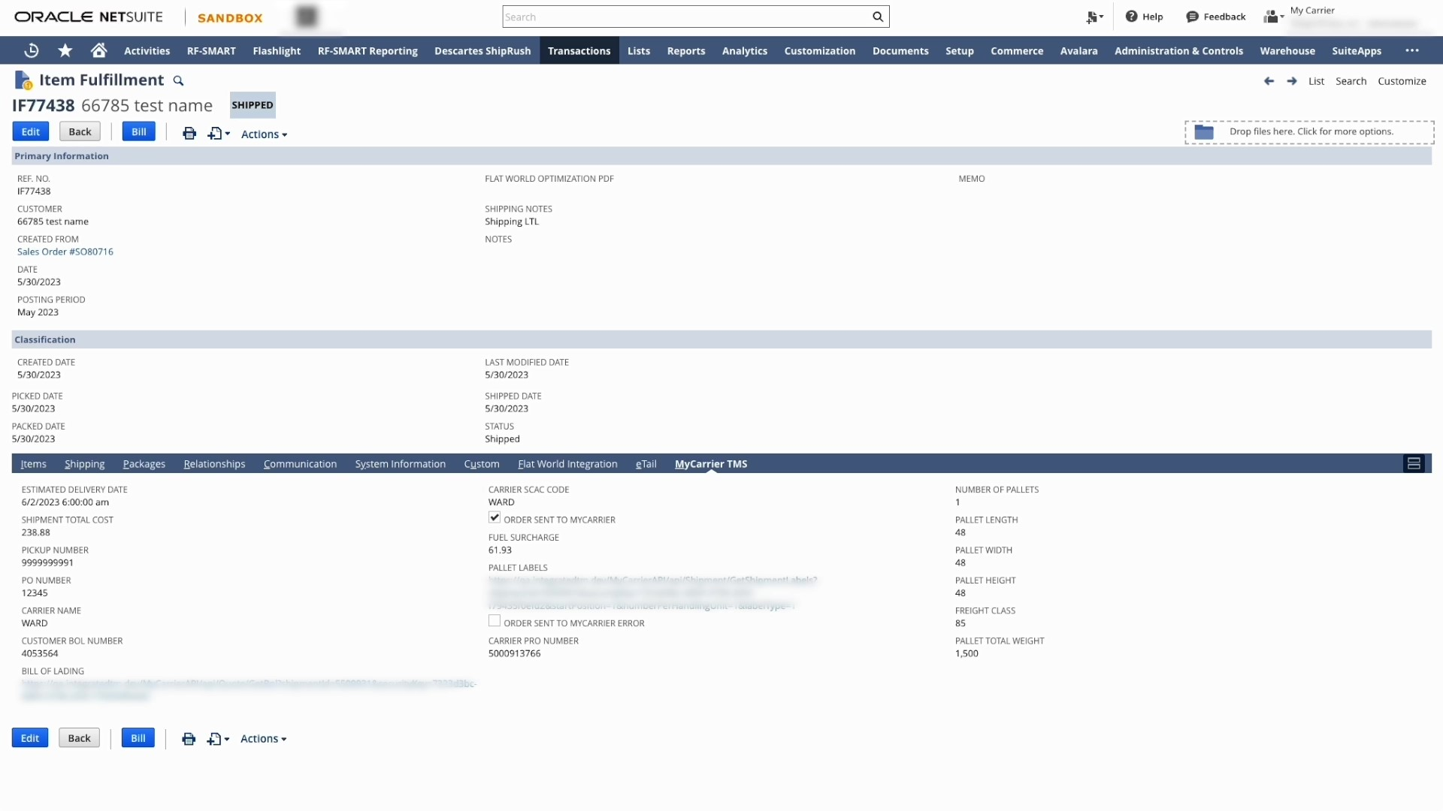
Get seamless order to shipment management with ERP integrations
We integrate with a variety of ERP and WMS technologies, including:
Netsuite
Acumatica
M365 Dynamics
Shopify
QuickBooks
Sage
Shopify
Odoo
Salesforce
Learn more about our integrations

Slide 25
Create better relationships with your carriers through electronic Bills of Lading
MyCarrier and our select partner carriers are excited to provide
the new industry BOL standard to shippers on our platform.
Shipper Benefits
Carrier Benefits
Improved accuracy on BOL documentation and reduced manual effort
Utilizes BOL data to initiate tracking, creating a more seamless customer experience
Faster processing time and direct integration with select carriers
Improves carrier ability to plan pickups and stops, promoting productivity
Increased shipment processing time and efficiency through instant communication
Enables contactless and paperless operations, supporting a sustainable environment

Slide 26
Gain a single source of truth
ERP / WMS / eCom System
Run rate quotes
Create bills
Work in your ERP, WMS, or MyCarrier and retain your data integrity. Our integrations enable you to:
Connect all your technology with a seamless integration through enhanced operational efficiency
Carriers
Return rate quotes
Dispatch
Track
Run rate quotes and select carriers directly in your ERP
Create payable records directly in your finance system
Use actionable data to make more informed decisions
Save time and scale more efficiently with less manual work
Financial System
Create payable records
Resolve invoice variances
Learn more about our integrations

Slide 27
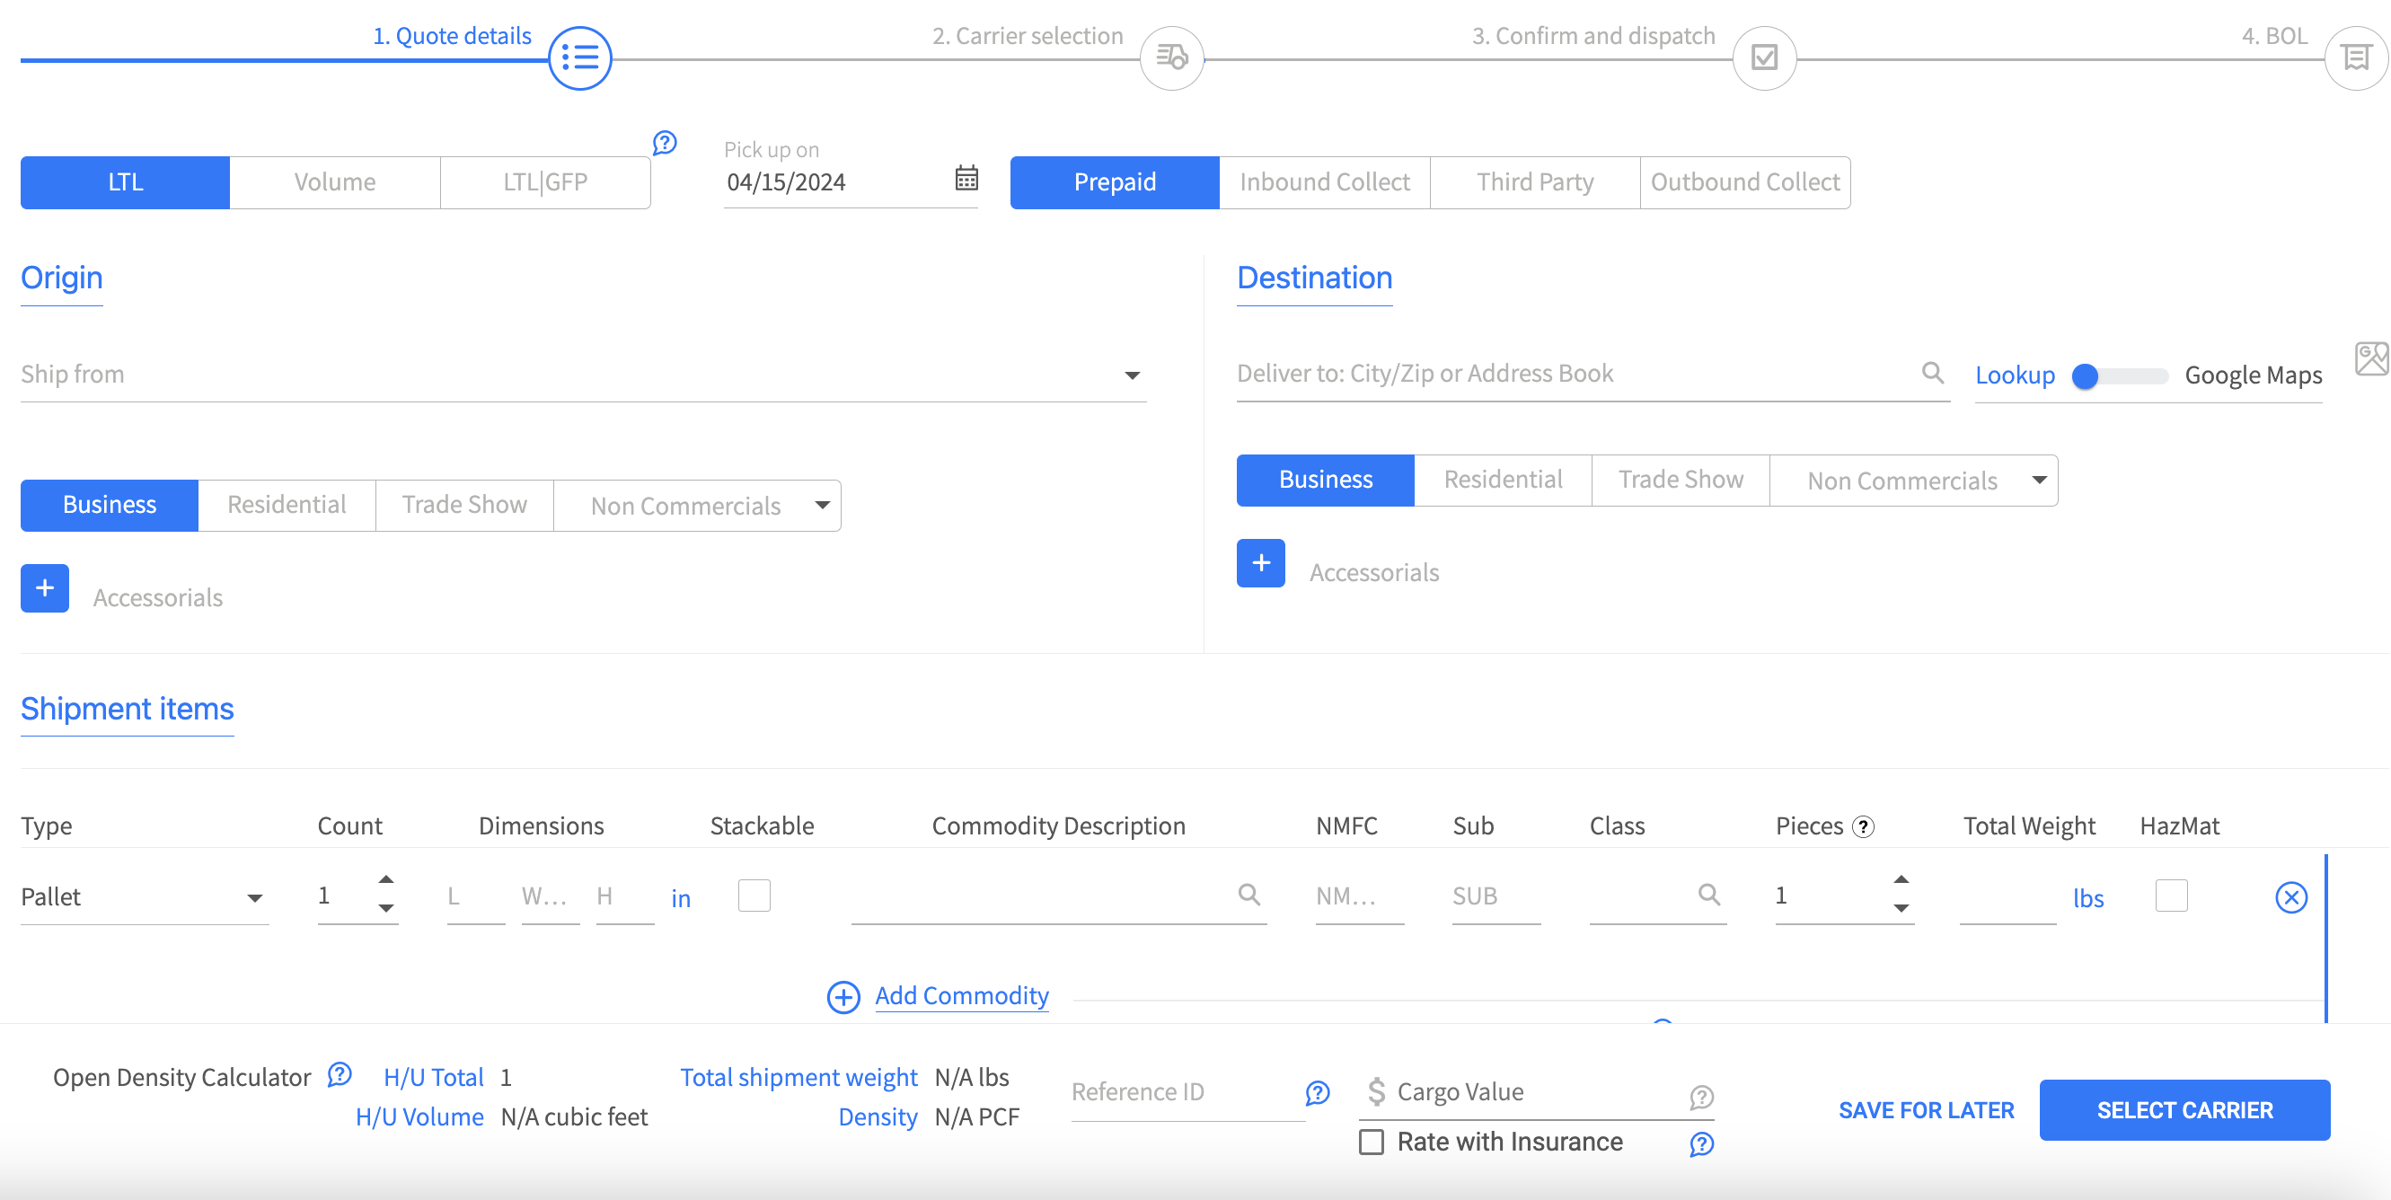
Quickly compare rate quotes and identify the right carrier
Connect to 70+ carriers
Quote and dispatch in just a few clicks
Receive auto-generated PRO numbers and shipping documents

Slide 28
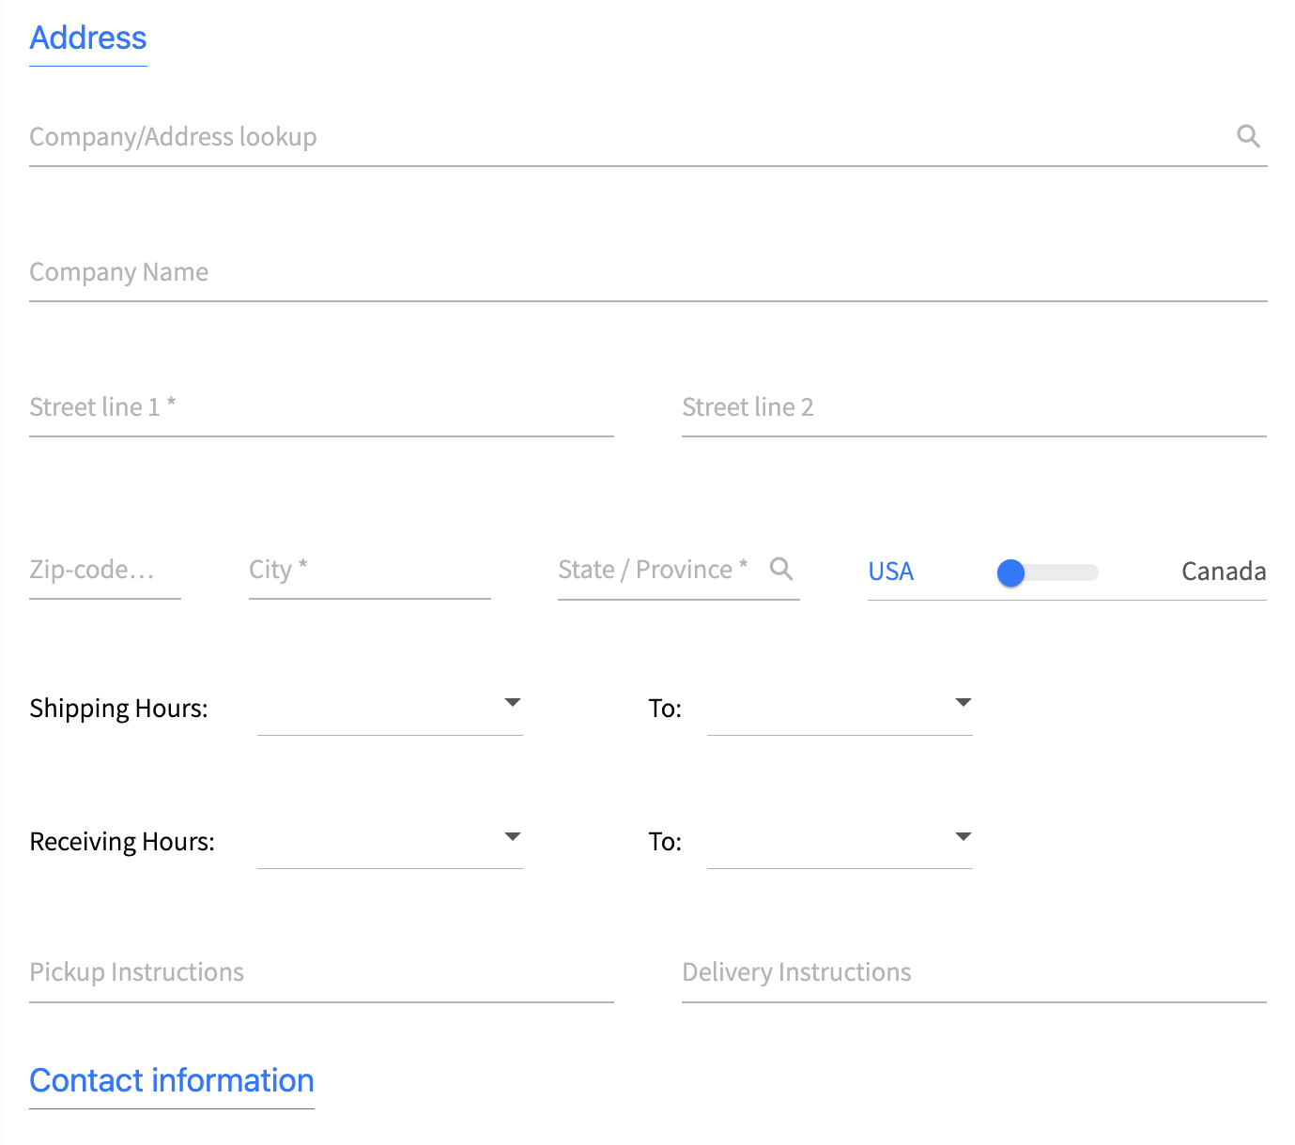
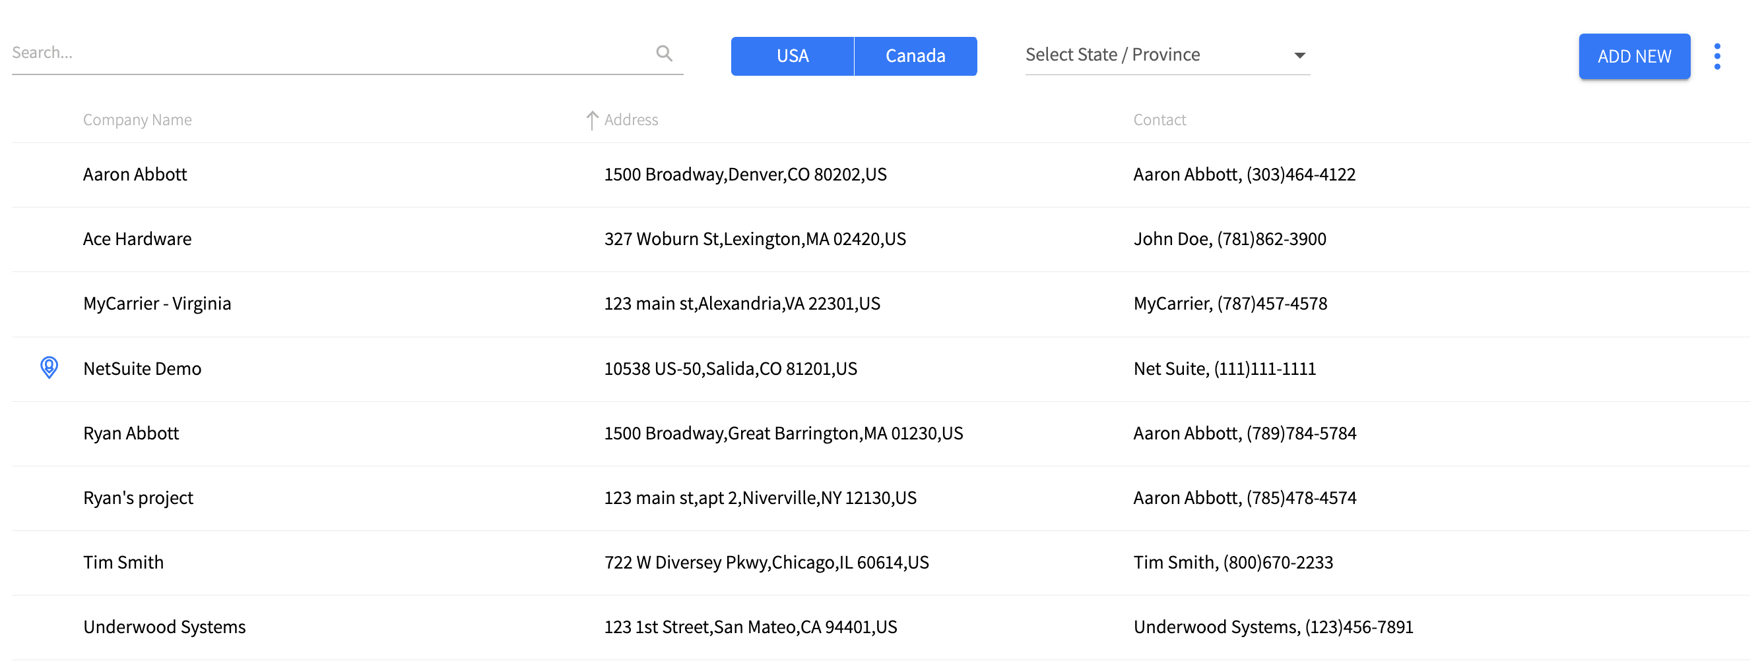
Save your regular shipping locations for quicker rating and dispatching
Quickly toggle between locations and limit user access by location.

Slide 29
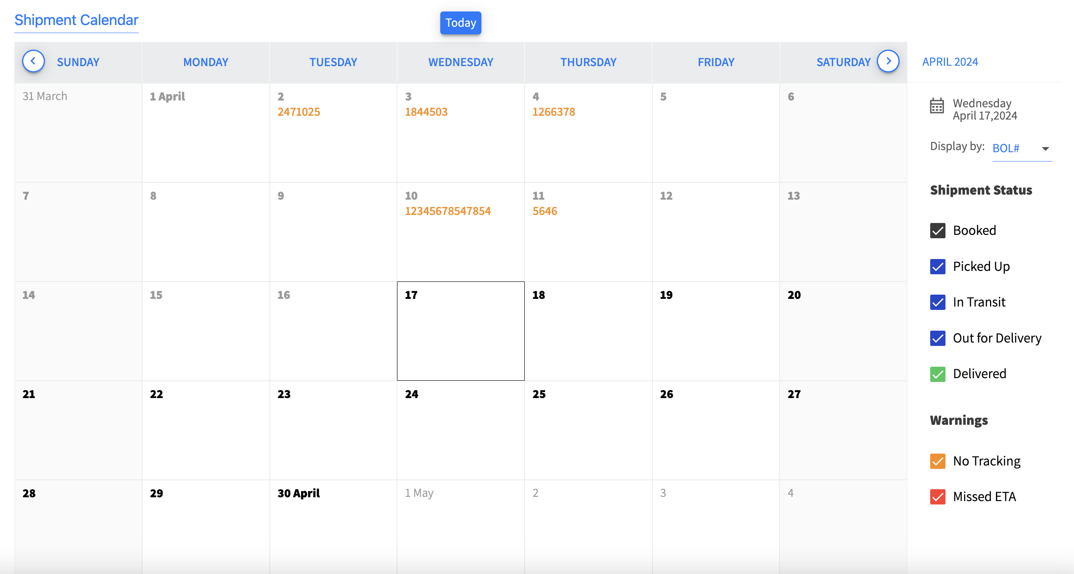
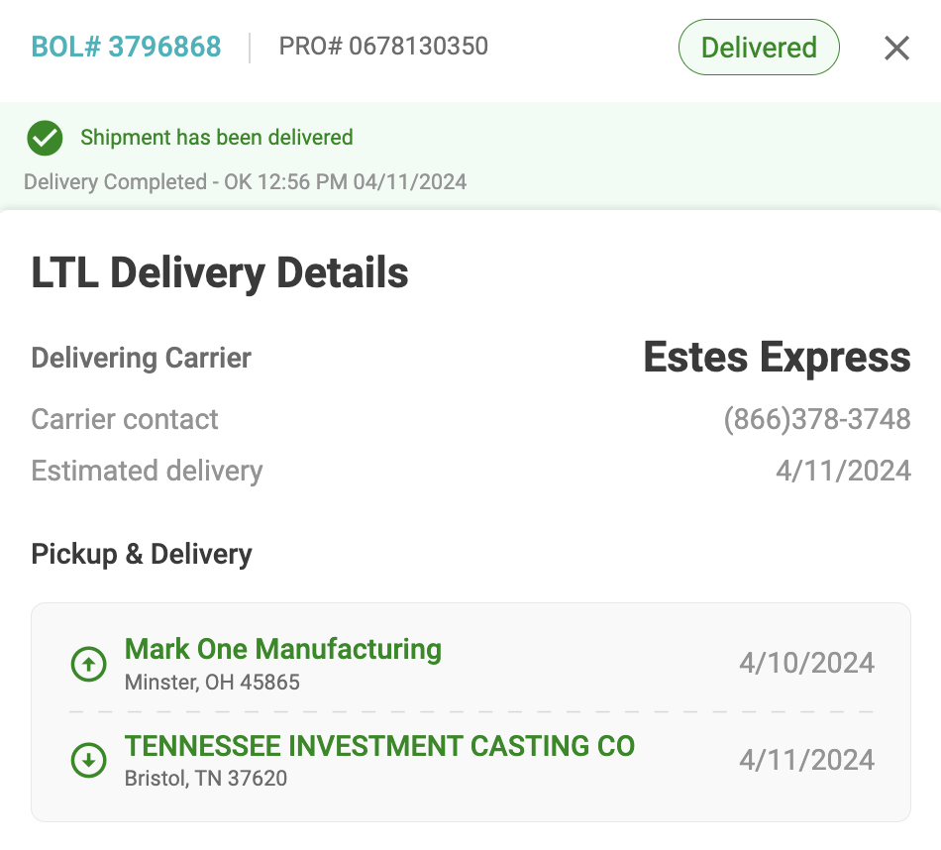
Stay informed and increase customer satisfaction
Send real-time tracking and automatic shipment notifications to customers.
BOL # 2467354
MyCarrier
Proactively send customer tracking information and automatically update them on delivery dates.
(602) 222 - 5680
04/11/2024
MyCarrier Manufacturing
Minster, OH 45865
04/09/2024
MyCarrier Casting Co
Bristol, TN 37620
04/11/2024

Slide 30
Access detailed shipment and carrier reports
Understand your market share and shipment profiles to make better business decisions.

Slide 31
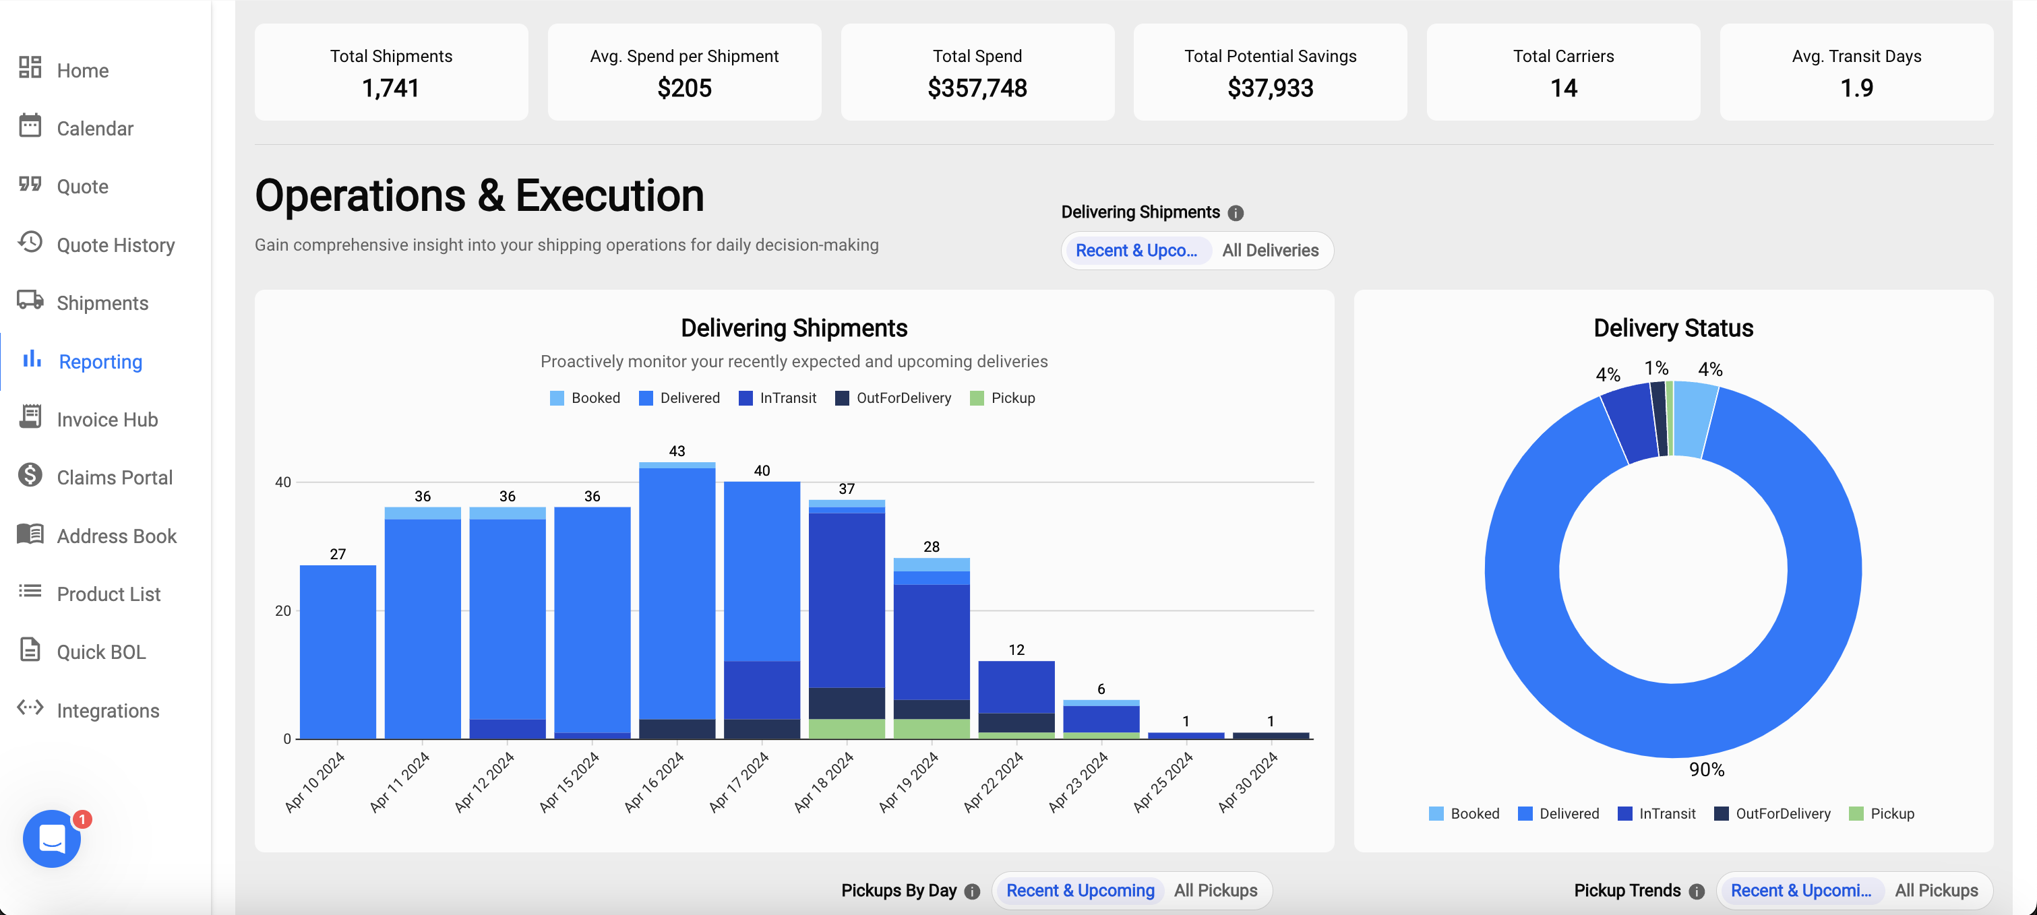
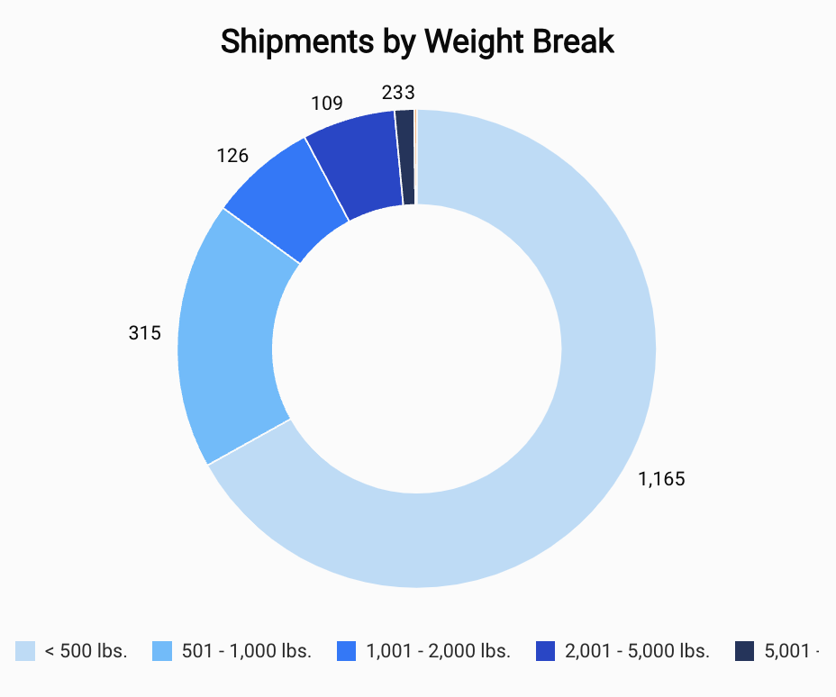
Make informed business decisions with Advanced Analytics
Optimize freight activity, identify trends, and minimize risks with Advanced Analytics.

Slide 32
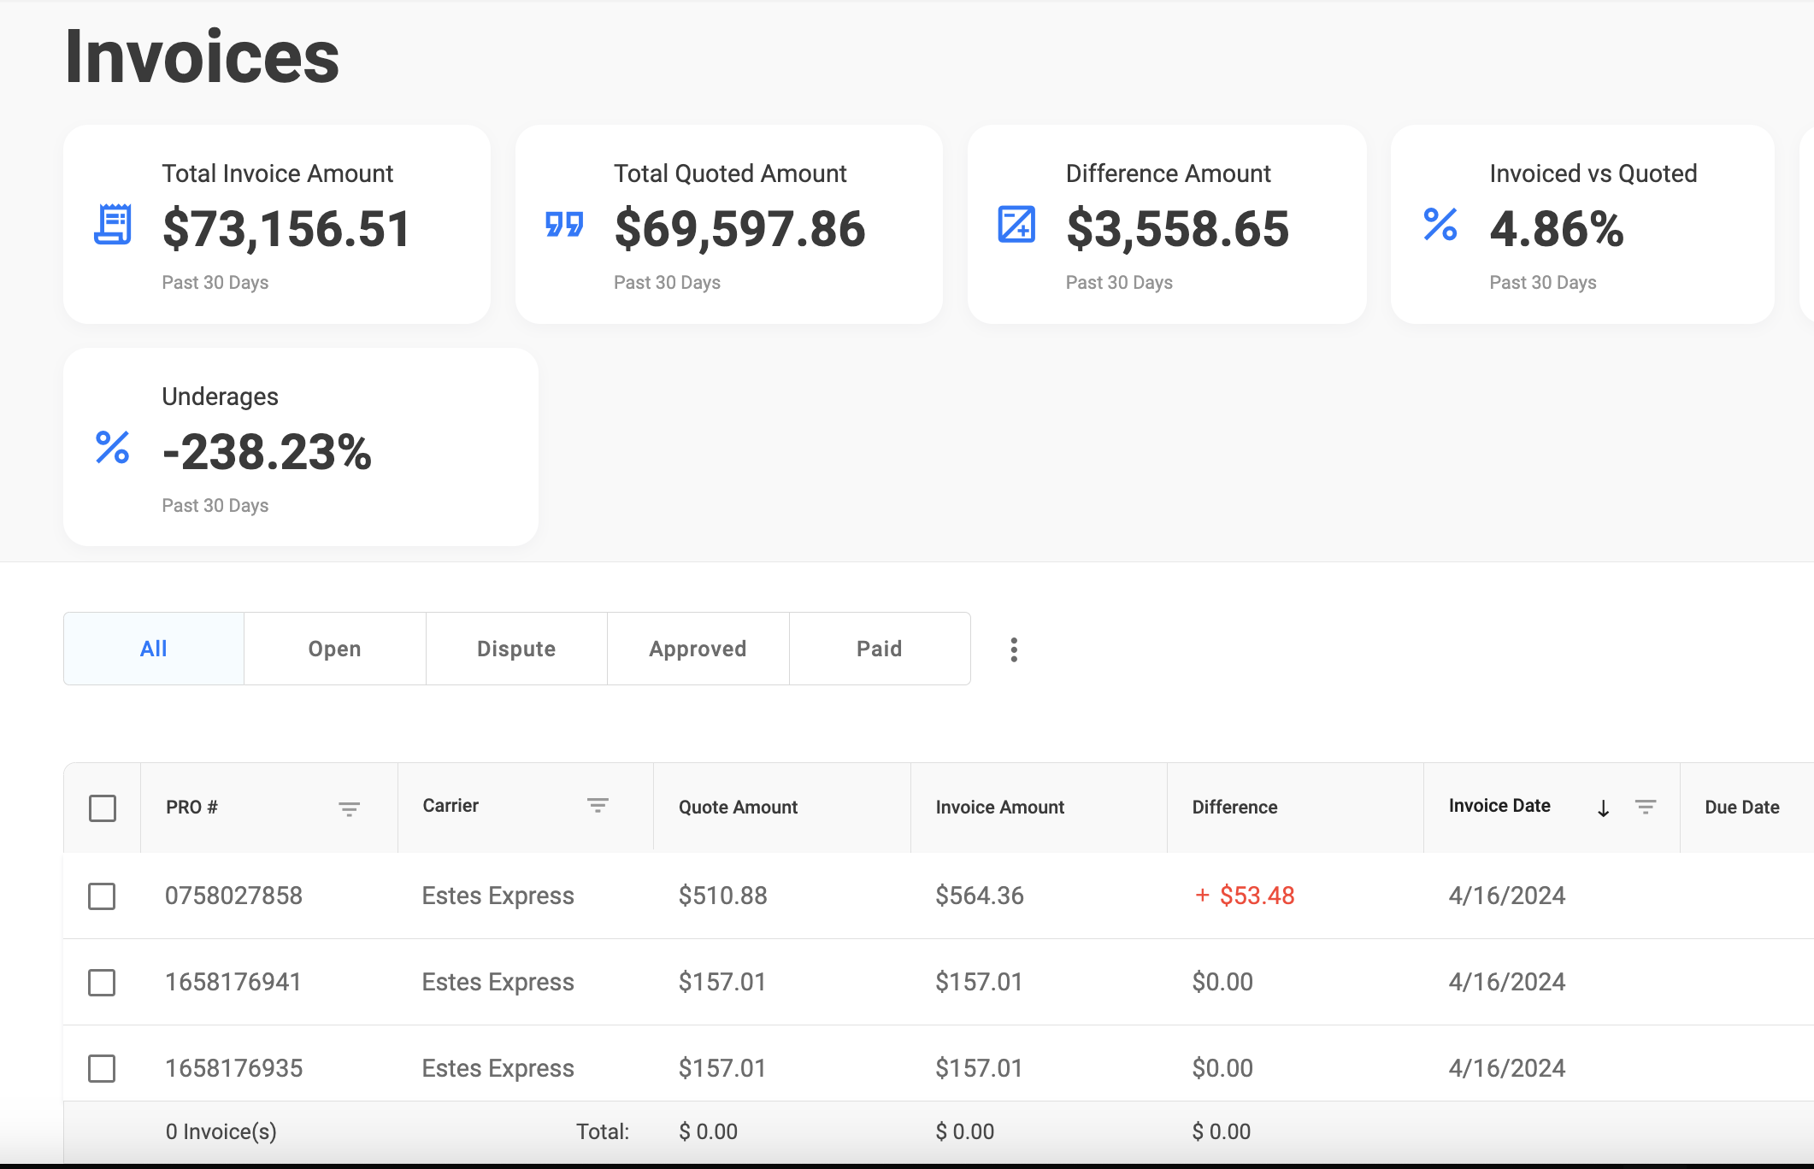
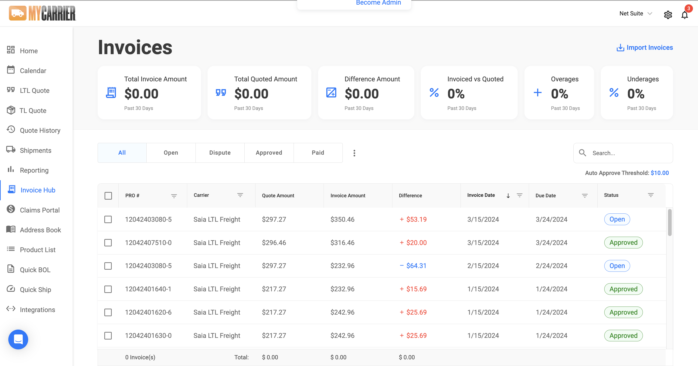
Manage freight bills and quickly resolve variances
MyInvoiceHub enables you to:
Electronically access your invoices
Compare invoices to quotes side-by-side
Identify and resolve variances
Mark invoices paid
83750275 MyCarrier
83752275 MyCarrier
83750283 MyCarrier

Slide 33
Hear from our shippers
Packaging supply division
Lucas Oil saves an average of $120,000 per year by utilizing the live rating options in MyCarrier.
U-Haul cut their monthly shipping costs by $66,000 by leveraging MyCarrier’s visibility and automation.
Ganesh Mills experienced a 253% ROI as a result of investing in MyCarrier’s platform with ERP integration and MyInvoiceHub.
Manidae Beauty Brands switched from a broker to MyCarrier, yielding a quarter million reduction in annual shipping costs.

Slide 35
Additional resources
Why MyCarrier
MyInvoiceHub
MyIntegrations
MyTruckload
Advanced Analytics
Full Value Protection
The Click Effect
Connecting the Pieces of Your Business

